Slide 1


ClimaSense
Climate Intelligence & Decision Support Platform
Transforming complex climate data into simple, actionable insights for researchers, farmers, NGOs, and policymakers.
Built at Hack It Out – Technex'26 for Byte the Bits.
Team: Shubham Kumar • Ritesh Singh • Aryan Raj Yadav
Institution: BBDNIIT
Date: 13 March 2026
Notes:
1

Slide 2






The Climate Data Problem
Climate data holds immense power to guide environmental decisions, but accessing and understanding it remains a significant barrier for most users.
Complex Formats
Time-Consuming
Accessibility Gap
Climate data stored in complex NetCDF formats that require specialized knowledge to extract and interpret
Researchers spend weeks manually extracting and processing usable climate data from raw datasets
Students and non-technical users struggle to understand raw climate datasets without extensive training
Regional Blindspots
Limited Detection
Policymakers lack clear, localized insights needed for effective environmental policy decisions
Environmental groups cannot detect climate anomalies and extreme events quickly enough
The Core Challenge: Climate data is incredibly powerful, but it's locked behind technical complexity that prevents widespread understanding and action.
Notes:
2

Slide 3
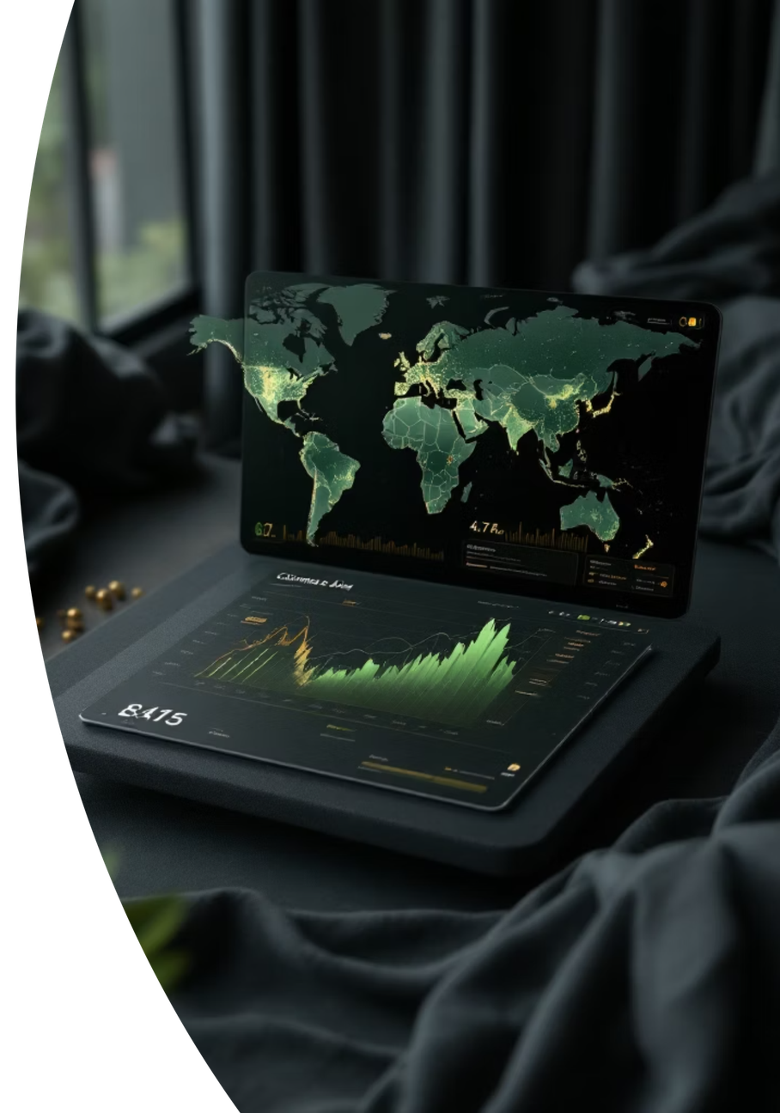




Introducing ClimaSense
ClimaSense converts complex climate datasets into an AI-powered exploration platform that helps anyone understand climate trends, detect anomalies, and make informed decisions—without requiring technical expertise.
Data Ingestion
Upload and read NetCDF climate datasets with simple drag-and-drop interface
Smart Processing
Python and Xarray process large climate data efficiently in the background
Interactive Visualization
Explore data through interactive maps, time series charts, and heatmaps
AI Insights
Detect anomalies, identify patterns, and predict climate trends using machine learning
Our platform bridges the gap between raw climate data and actionable intelligence, making environmental insights accessible to everyone from students to policymakers.
Notes:
3

Slide 4

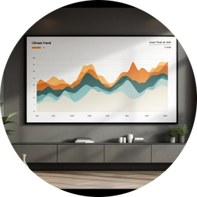


Powerful Climate Intelligence Tools
ClimaSense provides a comprehensive suite of features designed to transform how users interact with climate data. From global mapping to predictive analytics, every tool is built with simplicity and power in mind.
Global Climate Mapping
Trend Analysis
Anomaly Detection
Predictive Modeling
Explore interactive maps displaying temperature, rainfall, wind patterns, and other climate variables across the entire globe with real-time data layers
Visualize climate patterns across months, years, or decades with intuitive time-series charts that reveal long-term trends and seasonal variations
AI-powered system automatically identifies unusual climate events, extreme weather patterns, and deviations from historical norms in seconds
Machine learning algorithms forecast potential future climate trends based on historical data, helping users plan for climate scenarios
Notes:
4

Slide 5
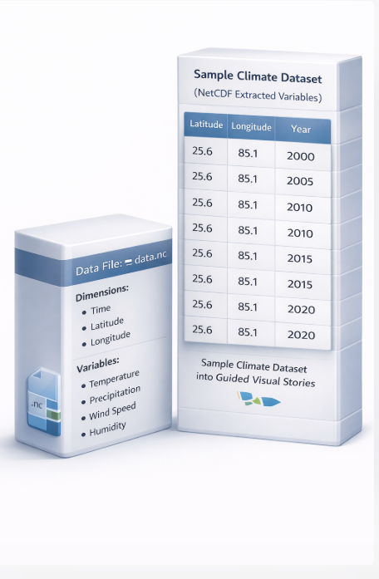
Actionable Climate Intelligence
ClimaSense transforms raw climate data into instant insights through an intuitive, user-friendly interface that requires no manual processing or technical expertise.
01
Select Location
Choose any location on the interactive world map using search or direct selection
02
Choose Metrics
Switch between temperature, rainfall, wind speed, humidity, and other climate variables with single-click controls
03
Set Time Period
Select specific months, years, or custom date ranges for historical or current analysis
04
Generate Report
Export professional-quality reports with charts, maps, and insights instantly in multiple formats
Key Benefit: No manual data processing required. Get climate insights in seconds instead of weeks, enabling faster decision-making and immediate action.
Notes:
5

Slide 6




Who Can Use ClimaSense
Our platform serves diverse users across different sectors, each benefiting from simplified access to complex climate intelligence.
Researchers & Scientists
Policymakers & Government
Accelerate climate analysis with faster data processing, automated extraction, and AI-powered pattern recognition. Spend less time on data wrangling and more time on breakthrough discoveries.
Access clear, localized climate insights for developing effective environmental policies, disaster preparedness plans, and long-term sustainability initiatives backed by data.
Students & Educators
Environmental NGOs
Learn climate science through interactive, real-world data exploration. Visual tools make complex concepts accessible, fostering deeper understanding and engagement in environmental studies.
Monitor climate risks, track environmental changes, and support conservation efforts with real-time data. Identify vulnerable regions and advocate for evidence-based environmental protection.
Notes:
6

Slide 7




Future Vision
We're continuously expanding ClimaSense's capabilities to provide even more comprehensive climate intelligence and real-time decision support.
Live Hazard Alerts
Automated AI Reports
Instant climate insights and personalized recommendations generated automatically based on user-selected regions and time periods
Real-time notifications for floods, heatwaves, droughts, and extreme weather events with predictive warnings and impact assessments
Global Climate Risk Index
Satellite Data Integration
Combine satellite imagery with climate datasets for comprehensive environmental monitoring and vegetation analysis
Comprehensive vulnerability measurement across regions, helping prioritize resources and identify most at-risk communities
Democratizing Climate Data for the Planet
Our mission is clear: empower better environmental decisions by making climate intelligence accessible to everyone. From farmers planning crops to governments crafting policy, ClimaSense transforms complex data into the insights that will shape our planet's future.
Notes:
7

